Slide 1
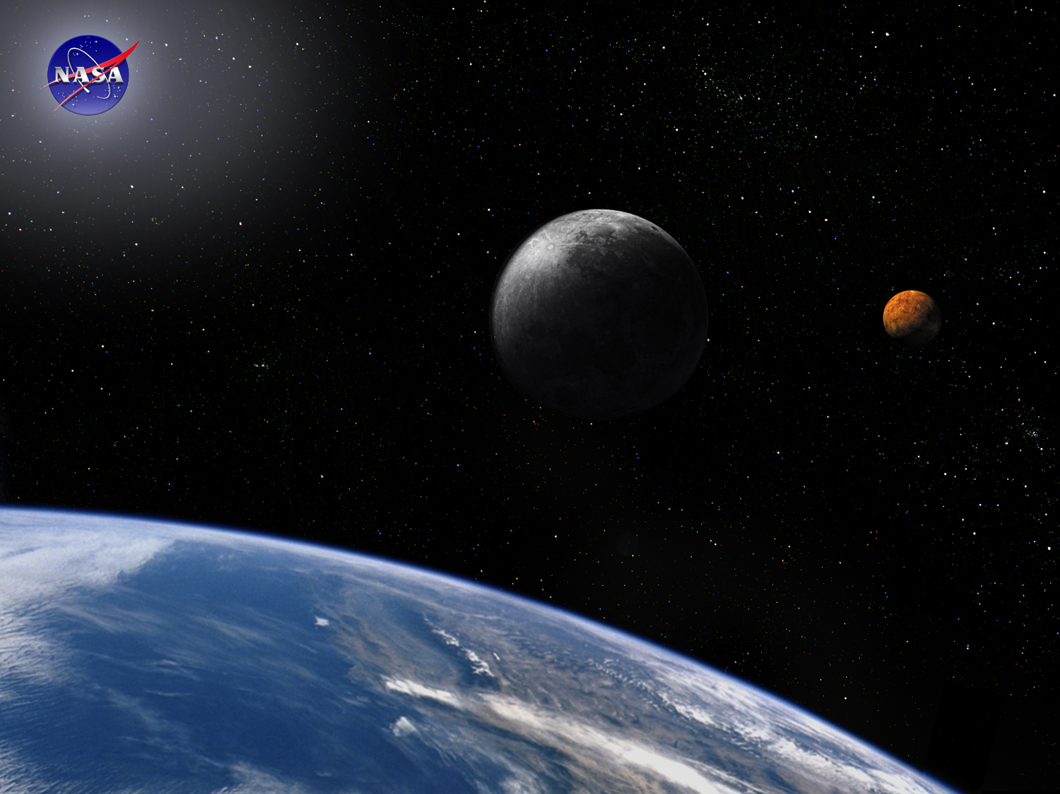
System Architecture Module
Space Systems Engineering, version 1.0
Notes:
Version 1.0
SOURCE INFORMATION:
The material contained in this lecture was developed by Lisa Guerra of NASA’s Exploration Systems Mission Directorate while on assignment in the Department of Aerospace Engineering at the University of Texas at Austin. As part of a course entitled, Space Systems Engineering, the lecture was piloted at UT-Austin in Spring 2008.
The content that follows was also reviewed and edited by Dr. Paul Graf, Adjunct Professor at the University of Colorado at Boulder.

Slide 2
Module Purpose: System Architecture
Place system architecture development in context with needs analysis, conops, functional analysis and system design.
Understand what system architectures are and some techniques for how they are developed.
Acknowledge that architecture development is usually an inductive process that benefits from heuristics and the experience of the systems engineer creating the architecture (who is also known as the system architect).

Slide 3
The Starting Point
“It must be remembered that there is nothing more
difficult to plan, more doubtful of success, nor more
dangerous to manage than the creation of a new system.”
- Niccolo Machiavelli, The Prince
Notes:
Published c. 1515

Slide 4
What Is an Architecture?
It is the fundamental and unifying system structure defined in terms of system elements, interfaces, processes, constraints, and behaviors.
  Source: International Council on Systems Engineering (INCOSE) System Architecture Working Group
It is the structure of components, their relationships, and the principles and guidelines governing their design and evolution over time.
  Source: Department of Defense (DOD) Architecture Framework v1.0
A system architecture is the link between needs analysis, project scoping and functional analysis and the first descriptions of the system structure.
Notes:
Pause and learn discussion topic:
What is the architecture of this building?
What is the architecture of the internet?

Slide 5
Developing A System Architecture
Creating an architecture is the beginning of the system design process and establishes the link between requirements and design. The typical architecture development sequence is:
Establish initial system requirements by needs analysis, project scoping, and the development of the concept of operations (conops).
Define the external boundaries, constraints, scope, context, environment and assumptions.
Develop candidate system architectures as part of an iterative process using these initial requirements.
For each architecture, compare the benefits, costs, risks and the requirements that drive their salient features and consider modifying (with stakeholder involvement) their conops, system performance and even their system functions to improve the solution-problem proposition.

Slide 6
Developing Candidate System Architectures is Recursive and Iterative
Needs Analysis
What needs are we trying to fill?
How are current solutions insufficient?
Are the needs completely described?
Who are the intended users?
How will the system be used?
How is this use different from heritage systems?
What capabilities are required?
At what level of performance?
Are segment interfaces well defined?
What is the overall approach?
What elements make up this approach?
Are these elements complete, logical, and consistent?
ConOps
Work With Customer to Potentially Modify Problem Statement Based on Solution Options
Functional Requirements
Work With Customer to Potentially Modify Problem Statement Based on Solution Options
System Architectures

Slide 7
So How Do We Create Architectures?
There are two primary techniques to create architectures, both benefit from understanding the performance and limitations of heritage systems.
Synthesis
  Modifying or combining existing systems to satisfy stated needs
  Requires logic and good knowledge of existing systems
  What functions do I need to get the job done?
  Can I combine existing systems without too much baggage?
Discovery
  Leverage knowledge of existing architectures to ‘discover’ a new one
  Requires knowledge of existing systems and abstraction skills
  Is there an analogous system in another domain?
  What are the good or bad properties of a given architecture?
Notes:
An architecture developed by synthesis: a new system for gathering world-wide meteorological data
An architecture developed by discovery: the first systems that allowed people to fly
On techniques for the creation of architectures (either synthesis and discovery) a neophyte needs to know that a fruitful place to start are the architectures of heritage systems.
System architecture developed by synthesis – most (all?) robotic spacecraft
System architecture developed by discovery – human flight

Slide 8
Four Deductive or Inductive Methods
Support Synthesis and Discovery
Science-based, deductive methods:
  Normative
    Hard rules are provided (from somewhere), success is defined by following the rules
    “If it doesn’t look like what we are doing now it must be wrong.”
  Rational
    Solutions derived from objectives
    General systems problem solvers, optimization and formal techniques
    Rule based
Art-based, inductive methods:
  Participative
    Solution from group process, design by group consensus. Stakeholders involved
  Heuristic
    Lessons learned based
    Develop solutions through soft rules that are driven by experience

Slide 9
Architecting Focuses on Refining the Problem to Be Solved While Developing Conceptual Solutions
The development of a system architecture, also called ‘architecting’, is a systems engineering responsibility. It is the art and science of purpose determination and concept formulation.
The essence of architecting is structuring, simplification, compromise, and balance.
This balance is achieved by appropriate compromise between:
  System requirements
  Function
  Form
  Simplicity
  Robustness
  Affordability
  Complexity
  Environmental imperatives, and
  Human factors
Candidate architectures are compared using these factors and a baseline, or agreed to system architecture is chosen.
  A choice is made despite the typically large uncertainties and occasionally ambiguous customer priorities.
Notes:
From Eberhardt Rechtin; Systems Architecting; 1991

Slide 10
Pause and Learn Opportunity
Have the students read the article on the Apollo architecture decision to use Lunar Orbit Rendezvous (Apollo_LOR_1971.pdf).
At the board, outline the alternative architectures that were under consideration for the Apollo missions.
Earth-orbit rendezvous
Direct ascent
Lunar-orbit rendezvous
Discuss the pros and cons of each and why LOR became the preferred architecture.
Notes:
Reading assignment for System Architecture lecture: “Selecting the Way to the Moon: the Choice of the Lunar Orbital Rendezvous Mode” by John Logsdon
(Apollo_LOR_1971.pdf)

Slide 11
Pause and Learn Opportunity, part 2
Extend the discussion to include NASA’s current plans on returning crews to the Moon using a combination of Earth-orbit rendezvous and Lunar-orbit rendezvous.
What are the resulting architecture elements?
What are the pros of this approach?
Use the speech by M. Griffin to get a better understanding of the NASA architecture (MG-STA-speech/ESAS-arch_1/22/08.doc).
View the architecture representation with the graphic on the next slide.

Slide 12


NASA Constellation Program
Lunar Sortie Mission Architecture (2006)
Ares V
Ares I
Notes:
Source:
CxP_70077-ArchitectureDescriptionDoc_9-22-06.doc
Definitions:
LSAM - Lunar Surface Access Module
LOI - Lunar Orbit Insertion
CEV - Crew Exploration Vehicle
Ares I - the crew launch vehicle
Ares V - the cargo launch vehicle

Slide 13
Architecture vs. Design
A system architecture creates the conceptual structure within which subsequent system design occurs.
Developing a system architecture and developing a system design are systems engineering functions that support system synthesis, but they have different uses.
System architecture is used:
  To establish the framework (i.e., constrains the trade space) for subsequent system design
  To support make-buy decisions
  To discriminate between alternative solutions
  To ‘discover’ the true requirements or the ‘true’ priorities
System design is used:
  To develop system components that meet functional and performance requirements and constraints
  To build the system
  To understand the system-wide ripple effects of configuration changes

Slide 14
Describing a Space System Architecture
No one figure or diagram can capture a system’s architecture - it requires different ‘views’ or perspectives.
Architecture descriptions are what we produce:
  Spacecraft renderings and subsystem block diagrams
  Space system communication flow diagrams
  Functional flow diagrams - sometimes captured in functional flow block diagrams (FFBDs; as discussed in Functional Analysis Module)
  Subsystem interface diagrams - frequently captured in N-squared diagrams (as discussed in Interfaces Module)
By analogy with a building architecture, these are the blueprints, elevations, floor plans, budgets, wiring plans, etc.

Slide 15
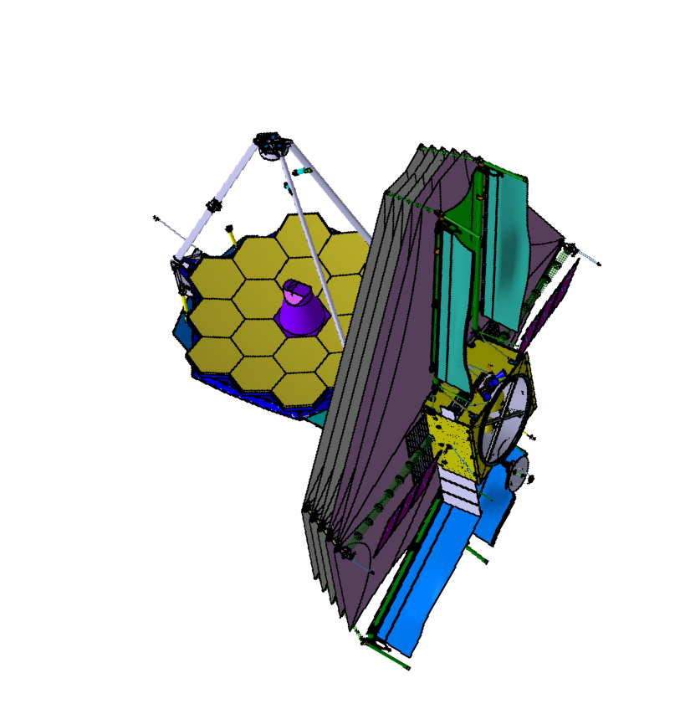
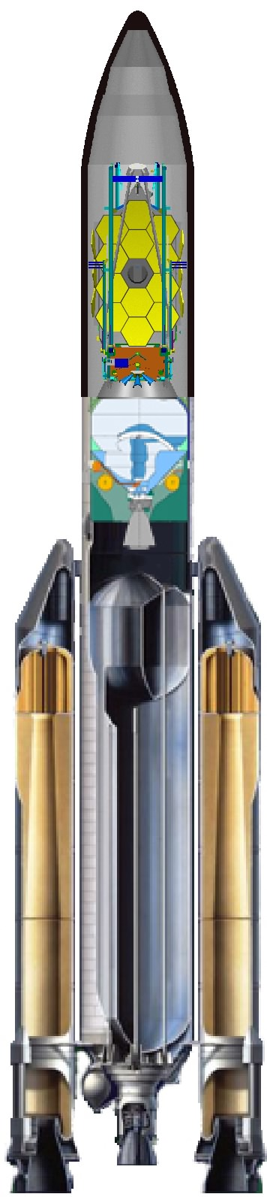

The James Webb Space Telescope
Communications Architecture
L2 Lissajous Orbit
Observatory
Segment
The launch vehicle injects observatory into an L2 transfer trajectory
The observatory operates at L2 point for 5 years with a goal of 10 years, providing imagery and spectroscopy in the Near and Mid Infrared wavebands.
The Ground Segment receives downloads of science data and sends command uploads during daily 4 hour contacts
Ground Segment uploads plans to the Observatory ~once a week and the observatory autonomously executes these plans
L2 Point
L2 Transfer Trajectory
STScI Science & Operations
Center (S&OC)
NASA Provided
Communication
Asset for Early
Orbit Phase
Observatory
Simulators
(OTB/STS)
Operations
Script
Subsystem
(OSS)
JPL
Deep Space
Network
(DSN)
Madrid
Goldstone
Canberra
Flight
Operations
Subsystem
(FOS)
Project
Reference DB
Subsystem
(PRDS)
NASA Integrated Services Network (NISN)
Wavefront
Sensing &
Control Exec
(WFSC Exec)
GSFC
Flight
Dynamics
Facility (FDF)
Launch
Segment
Ground Segment
Data
Management
Subsystem
(DMS)
Proposal
Planning
Subsystem
(PPS)

Slide 16
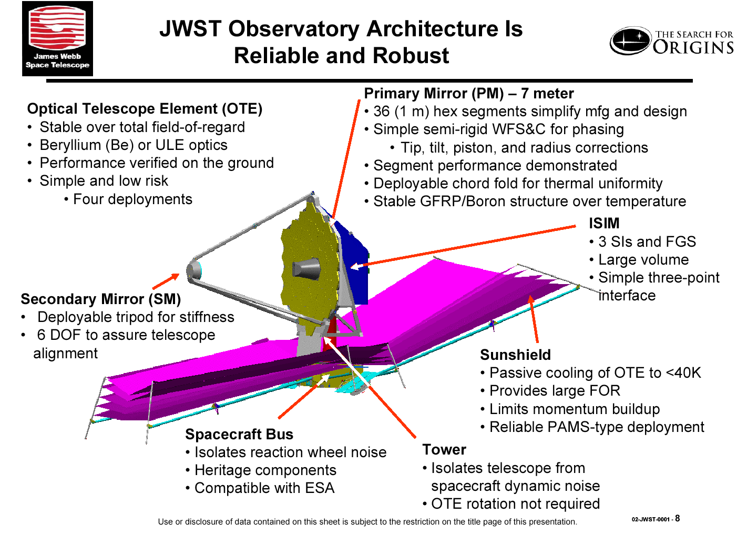
Notes:
A spacecraft rendering showing the subsystems and some of their primary features.

Slide 17
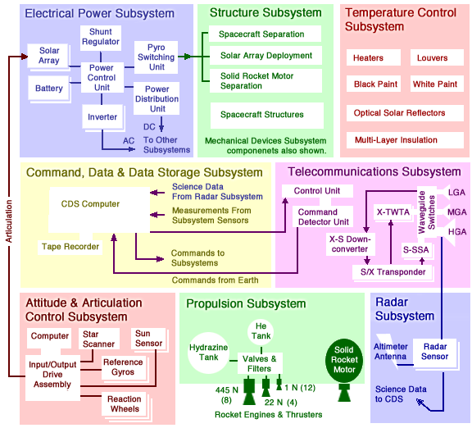
Magellan Spacecraft Subsystem Block Diagram Shows Some of its Communications Interfaces

Slide 18
Module Summary: System Architecture
Creating a system architecture is a systems engineering function that is the first step in translating a defined problem into a solution.
Creating an architecture is a recursive, iterative process that begins with the problem statement, creates some candidate solutions, assesses their merits and chooses one.
Architecture creation is not a deterministic process, but understanding the strengths, weaknesses and adaptability of heritage or analogous systems is a valuable first step.
In working with the stakeholders, the function or performance requirements of the system may be modified to create a better match between the problem statement and the candidate solution.
Like many systems engineering functions, architecting is one of balancing competing factors and choosing a preferred solution with uncertain and sometimes ambiguous information.
No one view captures an architecture. Many views are used to capture the system structure defined in terms of system elements, interfaces, processes, constraints, and behaviors.

Slide 19
Backup Slides for System Architecture Module

Slide 20
Building Architectures
Illuminate by Analogy
The architect works for the client and with the builder.
You expect the architect to help develop requirements.
  Both architects and systems engineers build self-consistent, balanced problem-solutions pairs.
Architects produce abstracted designs.
  Floor plans, elevations, cost estimates, etc. are not complete building plans, but they are necessary for complete building plans.
Architecture descriptions and the architecture itself are different.
  The floor plan is not the architecture, nor is the elevation, nor is the cost estimate.
A good architecture representation is not just the physical structure, there are many views.
Mark Maier and Eberthardt Rechtin - The Art of Systems Architecting; CRC Press, 2000
Notes:
This chart was produced by Paul Graf (Univ Colorado-Boulder). The analogy is a bit confusing, but the reader could probably discuss the idea.
The book may be a very good reference for the topic of systems architecture development.

Slide 21
The Three Views of the DOD Architecture Framework
Notes:
Source?

Slide 22
Elements of Pre Phase A
Mission Architecture
• Mission Overview
• Science Objectives
• Quad Chart
• Technology Needs and Assessment
• Project’s Relation to Program
• Mission Requirements
• Project System Description
  - Key Drivers (hardware & software)
  - Redundancy
  - Fault Protection Concept (hardware & software)
  - Architecture
  - Software Architecture
  - System Trades
  - Flight System Mass Breakdown (w. margins)
  - Flight System Power Breakdown (w. margins)
  - End-to-End Information System Concept
  - Data Return Budget and Margins
  - Design Principles Exceptions
  - System Margin Summary: mass, power, cost, performance
• Mission Description
  - Environmental Conditions
  - Key Drivers
  - Mission Trades
  - Orbit and Trajectory (w. margins)
  - Navigation Concept
  - Launch Vehicle: Packaging, Mass and Margin; Stowed Configuration; Launch Strategy
• Payload Conceptual Design
  - Payload Configuration Diagram (s), Stowed and Deployed
  - Block Diagram
  - Heritage (hardware & software)
  - Mass (w. contingency)
  - Power (w. contingency)
  - Size (w. contingency)
  - Data Rates
  - Pointing Characteristics
  - Thermal Characteristics
  - Software Description
  - Technology Maturity Matrix
• Flight System Descriptions (bus,lander, etc.)
  - Configuration Diagram (s), Stowed and Deployed
  - Subsystem Concepts & Block Diagrams
  - Heritage (hardware & software)
  - Mass (w. contingency)
  - Power (w. contingency)
  - Size
  - Downlink/Uplink Rates
  - Pointing Capability
  - Thermal Capability
  - Software Description
  - Technology Maturity Matrix
• Mission Operations Concept
  - Concept Description
  - Key Drivers
  - Operations Scenario
  - Flight/Ground Interface
  - Overview of Mission-Critical Scenarios
  - Ground Data System
  - DSN Support or Other Ground Stations
  - Software Description
  - Data Archive Concept
  - Technology Maturity Matrix
• Project implementation Approach
  - WBS, WBS Dictionary
  - Implementation Approach (who does what)
  - Project Organization Chart
  - JPL Workforce Estimates
  - Project Schedule
  - Planetary Protection Strategy
  - Launch Approval Strategy
  - Outreach & Commercialization Plan
• Constraints
• Requirements Flowdown/Mission Traceability Matrix
  - Science -> Mission -> System
  - Requirements and Constraints Compliance Matrix (L1 requirements, HQ, programmatic, institutional)
• Verification/Validation Description
  - ATLO
  - Environmental Qualification
  - Mission V&V
  - Software
  - Fault Protection
• Technology Development Approach
  – Technology List
  – Technology Readiness Levels (TRL’s)
  – Key Technology Descriptions
  – Technology Development Milestones
• Risk Management Approach
  - Risk Assessment and Mitigation Strategy and Risk Rating
  - Risk List
• Costs and Risk Summary
  - Cost-Risk Estimates by Phase and WBS (w/ reserves)
  - Schedule Risk (w/ reserves and critical path identified)
  - Design-to-Cost-Risk Trades
• JPL Institutional Impact Assessment
  - Workforce Needs
  - Facilities
  - DSN Usage
  - Budget
  – % Probability of Proceeding to Implementation
Notes:
Source: Tony Freeman; Section Manager; Mission & Systems Architecture (section 311); JPL

Slide 23
Product Architecture
Product architecture is the arrangement of the physical elements of a product to carry out its required functions
It is in the Embodiment design phase that the layout and architecture of the product must be established by defining what the basic building blocks of the product should be in terms of what they do and what their interfaces will be between each other. Some organizations refer to this as system-level design
There are two entirely opposite styles of product architecture, modular and integral:
  Modular: components (chunks) implement only one or a few functions and the interactions are well defined
  Integral: implementation of functions uses only one or a few components (chunks) leading to poorly defined interactions between components (chunks)
In integral product architectures components perform multiple functions
Products designed with high performance as a paramount attribute often have an integral architecture
Notes:
Source:
George Dieter; Engineering Design: A Materials and Processing Approach
McGraw-Hill Higher Education, 2000
Chapter 6; Section 6.2

